Slide 1
Brain Tumor Detection
By:
Muhammad Owais Mushtaq [18K-1177]
Rethek Kumar [18k-0242]
Yougesh [18k-0290]
[Comparison between CNN and Pre-trained Model] [Based on MRI Images]

Slide 2

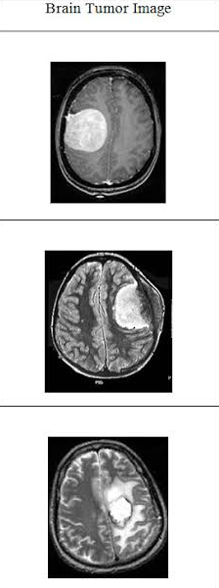
Table of Content
01
Introduction
02
Problem Statement
03
Solution
04
Motivation
05
Dataset
06
Methodology
07
CNN
08
Pre-trained Model
09
Conclusion
10
References
11
Q / A

Slide 3
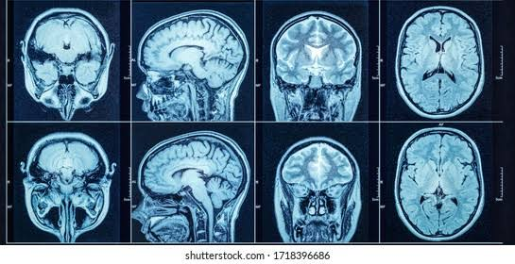
Introduction
Problem Statement:
Brain tumors are the most destructive disease, leading to a very short life expectancy in their highest grade. The misdiagnosis of brain tumors will result in wrong medical intercession and reduce the chance of survival of patients. The accurate diagnosis of brain tumors is a key point to make proper treatment planning to cure and improve the existence of patients with brain tumor disease.

Slide 4
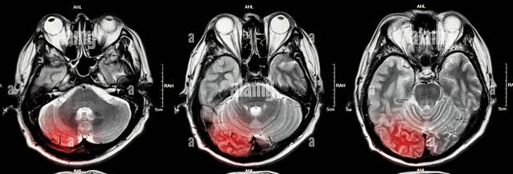
Introduction
Solution:
The computer-aided tumor detection systems and convolutional neural networks provided success stories and have made important strides in the field of machine learning. The deep convolutional layers extract important and robust features automatically from the input space as compared to traditional predecessor neural network layers. Hence, we will firstly build a custom model through CNN and then we will use pre-trained model on the same dataset to achieve better accuracy.

Slide 5
Motivation
Brain tumor classification is an important problem in computer-aided diagnosis (CAD) for medical applications. Furthermore, the solution to this problem can save the chance of survival of numerous patients because the accurate diagnosis of brain tumor is a key point to make a proper treatment planning to cure.

Slide 6
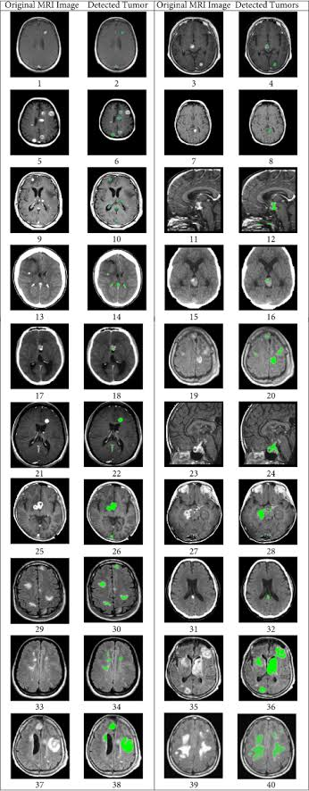
Dataset
For Dataset selection, we have used MRI images dataset which is available on Kaggle.However, the size of the dataset was not as large as any Deep Model requires for better training. Hence, we have used some data generation techniques such as Data Augmentation(Vertical Flip) to increase the data, and we combined different small datasets together
Dataset Size for both models have been kept same to compare models effectively and efficiently.

Slide 7
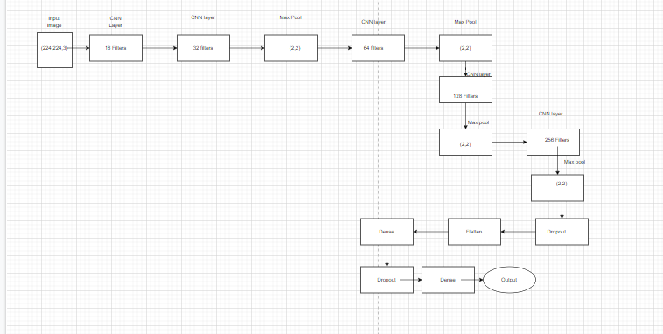
CNN Model Implementation
Firstly we input the image and pass through the CNN model to achieve output

Slide 8
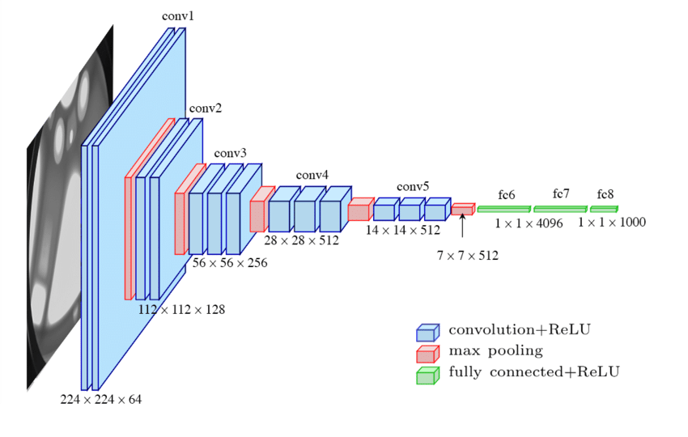
Pre-trained Model Implementation
For the Pre-Trained Model, we have used VGG16 which is a pre-trained Convolutional Neural Network which is 16 layers deep. For the final layer we have used sigmoid for binary classification, with adam optimiser to reach global minima.

Slide 9
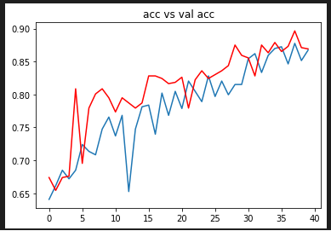
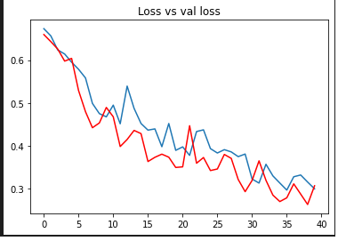
Results of CNN model
Given Below are the charts for CNN model Accuracy and Validation Accuracy and Loss and Validation Loss.

Slide 10
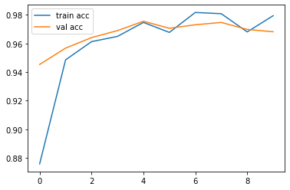
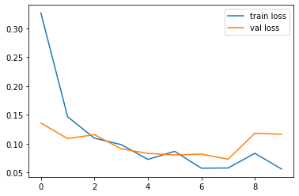
Result of Pre-trained model
Given Below are the charts for Pre-trained model Accuracy(train and Validation) and Loss(train and Validation).

Slide 11
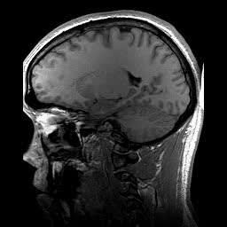
Conclusion
We have reached a conclusion through comparing the accuracy of both models trained on the same size of data that there is a 8% increase in accuracy in pre-trained models. The VGG16 pre-trained model turned out to be more efficient along with being more accurate.The Train/Test/Valid split Ratio for both models were kept the same at 70/15/15.
However, CNN model turned out to be pretty accurate and reliable and can be further improved over different tuning methods.In the end, VGG16 was simple to incorporate and provided 97.95% Accuracy on test data.Whereas,CNN Network stood at 89.16% accuracy.

Slide 12
Reference
J. Cheng, W. Huang, R. Shuangliang Cao, W.Y. Yang, Z. Yun, Z. Wang, Q. Feng, Enhanced performance of brain tumor classification via tumor region augmentation and partition. PLoS ONE 10(10), e0140381 (2015)
J. Cheng, W. Yang, M. Huang, W. Huang, J. Jiang, Y. Zhou, R. Yang, J. Zhao, Y. Feng, Q. Feng, Retrieval of brain tumors by adaptive spatial pooling and fisher vector representation. PLoS ONE 11(6), e0157112 (2016)
M.R. Ismael, I. Abdel-Qader, Brain tumor classification via statistical features and back-propagation neural network. In 2018 IEEE International Conference on Electro/Information Technology (EIT), pp. 0252–0257. IEEE (2018)
T.A. Abir, J.A. Siraji, E. Ahmed, B. Khulna, Analysis of a novel MRI based brain tumour classification using probabilistic neural network (PNN). Int. J. Sci. Res. Sci. Eng. Technol. 4(8), 65–79 (2018)
Dataset References:
https://www.kaggle.com/navoneel/brain-mri-images-for-brain-tumor-detection
https://www.kaggle.com/sartajbhuvaji/brain-tumor-classification-mri
https://figshare.com/articles/dataset/brain_tumor_dataset/1512427

Slide 13
Any Question?

Slide 14
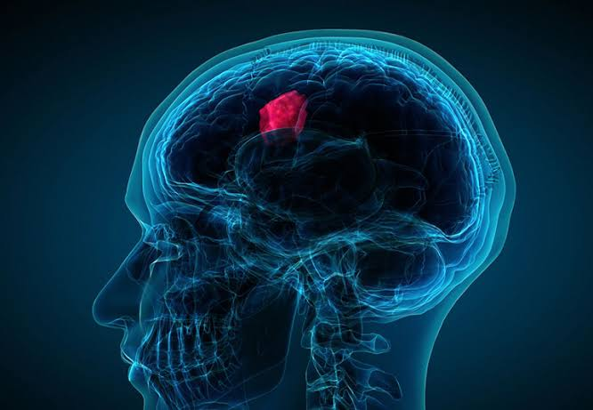
Thank You!

